Slide 1

Tobacco’s Impact on General Health and Mortality

Slide 2


Tobacco use is an important health risk for Jenu Kuruba women.

Slide 3
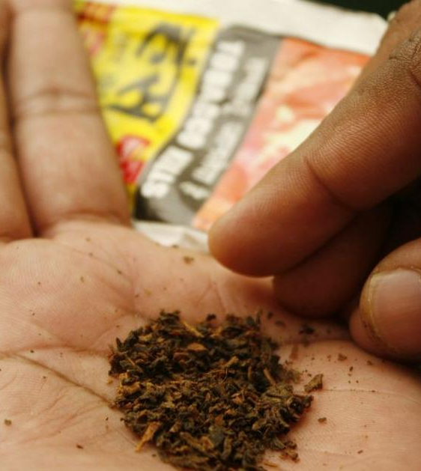
People usually use tobacco…
For pleasure
To satisfy nicotine addiction
For social purposes
For rituals

Slide 4

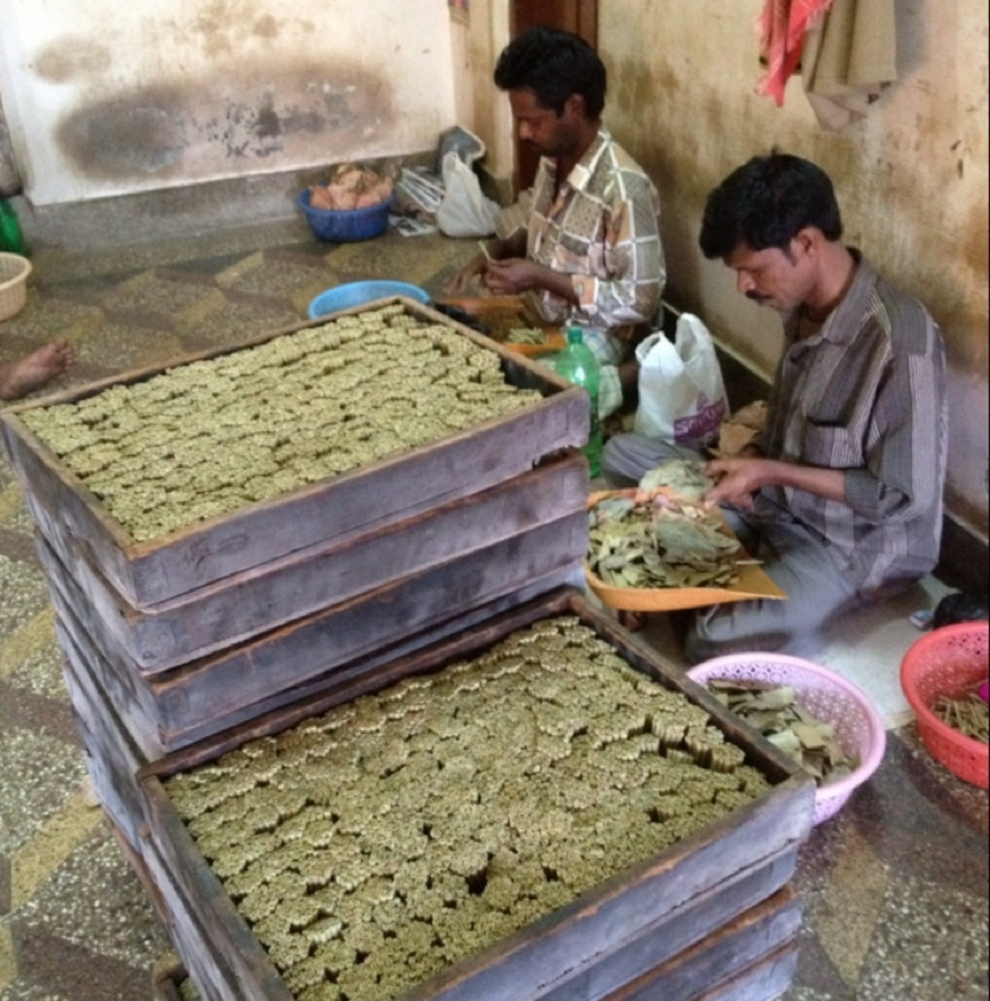
Even though smokeless tobacco might be an important part of culture and your economic livelihood, it can lead to many negative health outcomes.

Slide 5
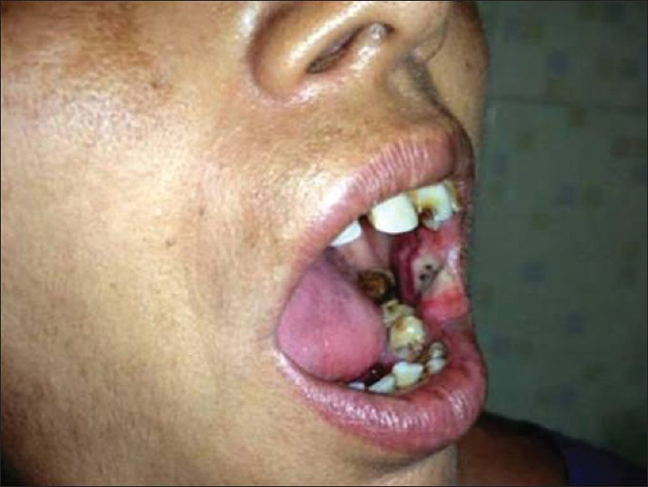
For example, smokeless tobacco can lead to cancer in your mouth and throat.

Slide 6
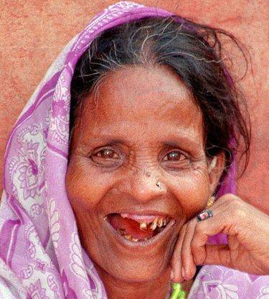
Using smokeless tobacco can cause other problems, such as tooth loss.

Slide 7
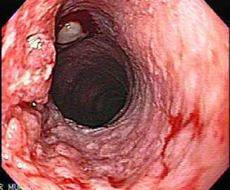
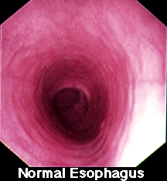
Smokeless tobacco can cause cancer in the stomach and the esophagus.

Slide 8
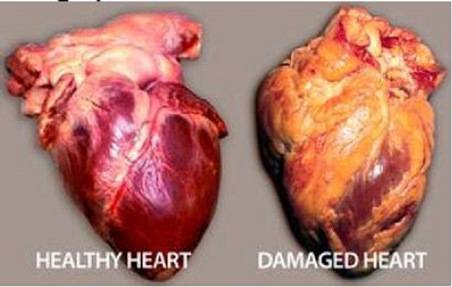
Smokeless tobacco can also cause heart disease

Slide 9
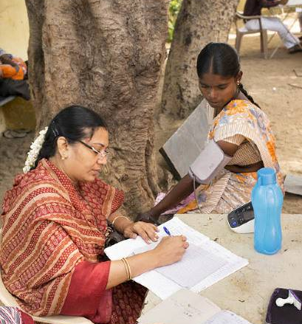
Smokeless tobacco can increase your blood pressure.

Slide 10
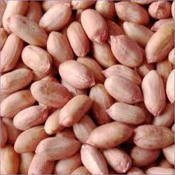
There are many ways to stop using smokeless tobacco. The first way is to replace tobacco with seeds or nuts.

Slide 11
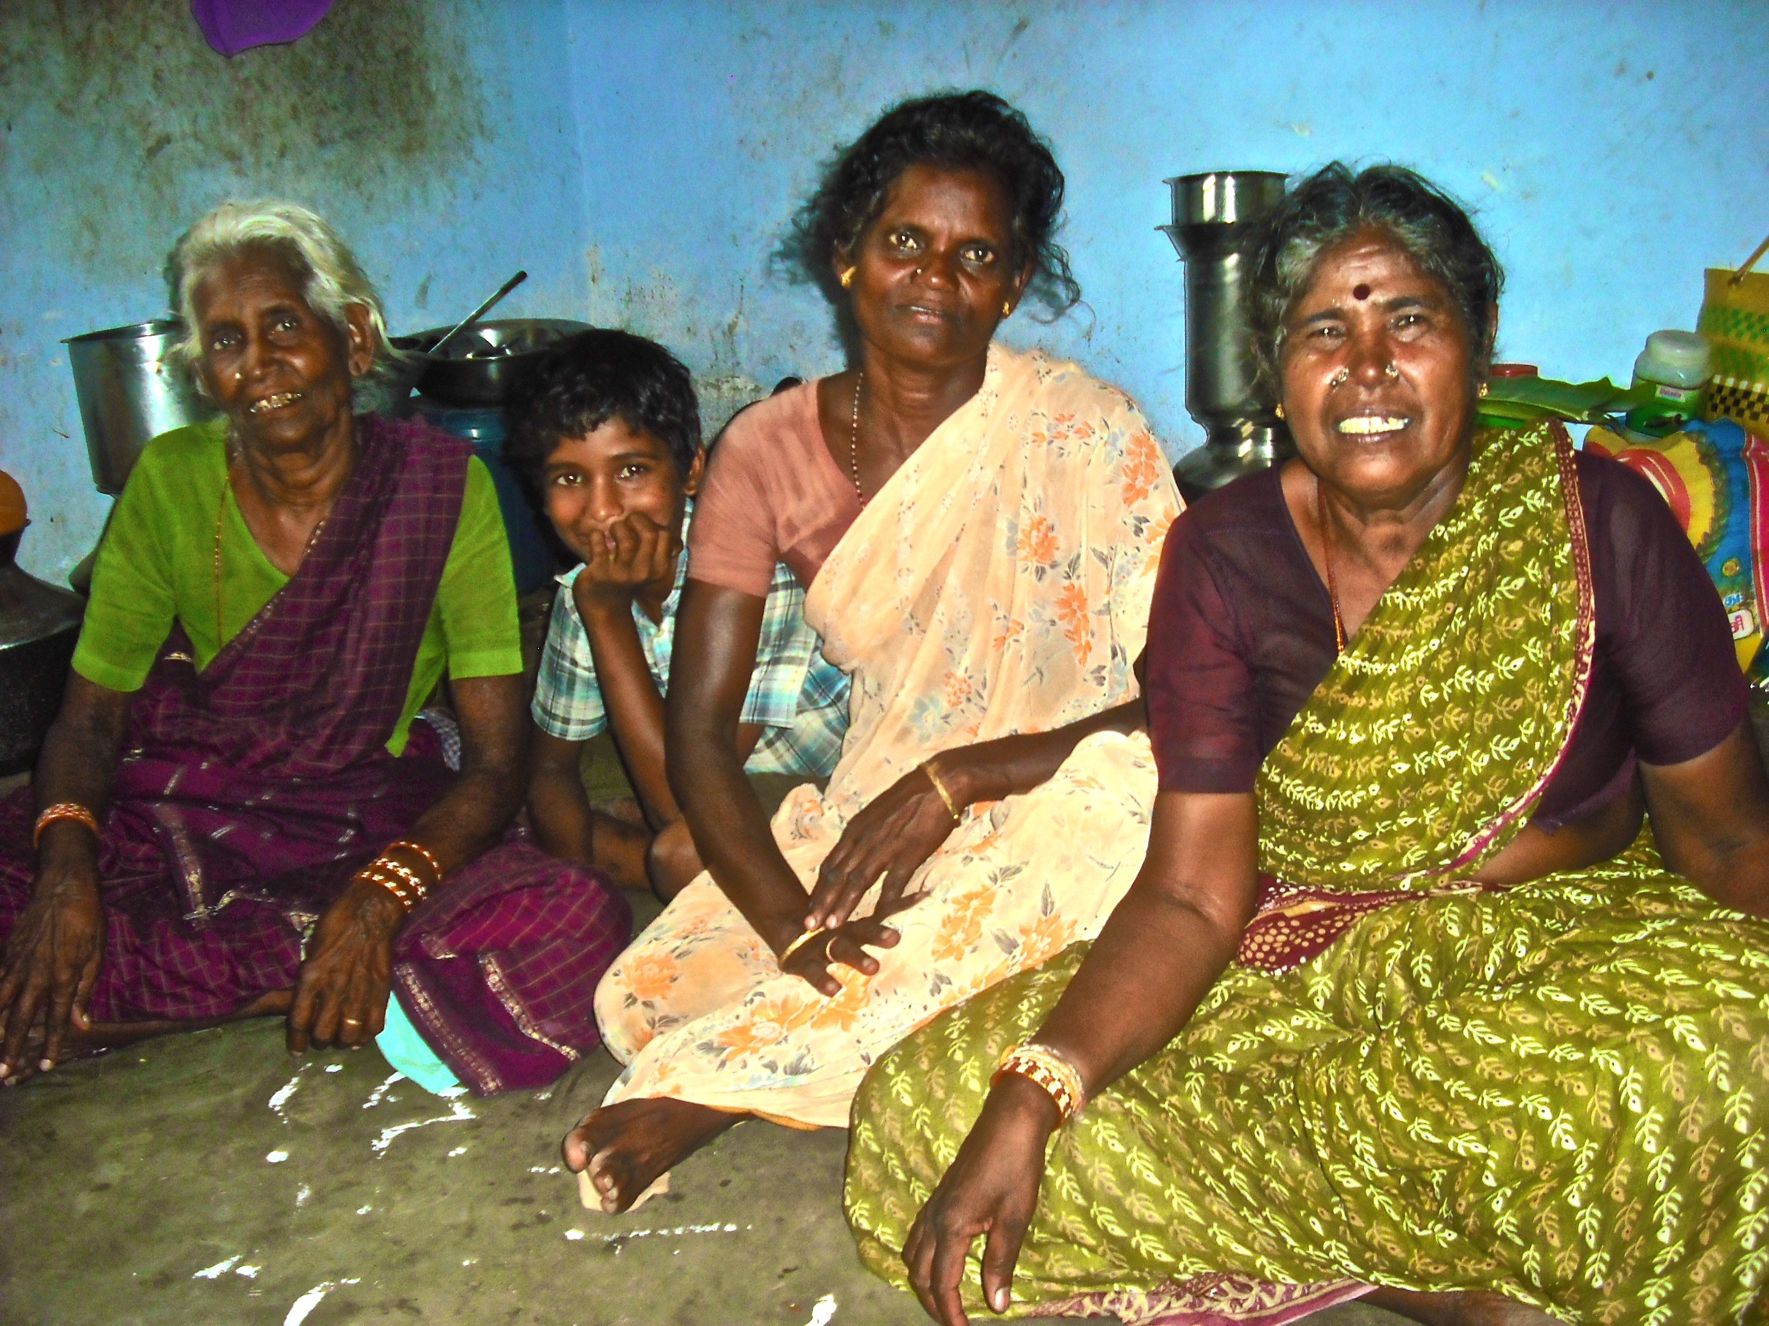
Rely on your friends and family for support. If they also use tobacco, then educate them on the health risks.

Slide 12
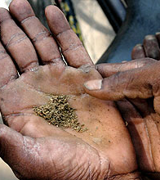
If quitting is too difficult, first try to cut your tobacco use by half.

Slide 13
Quiz Question
What are 5 ways that smokeless tobacco impacts your health?

